Slide 1
Chapter 10
How to work
with strings

Slide 2
Applied objectives
Code, test, and debug programs that work with strings. That includes:
slicing a string
finding and replacing parts of a string
splitting a string into a list of strings
joining the items in a list into a string

Slide 3
Knowledge objectives
In general terms, describe the coding that’s used for Unicode characters.
Describe these built-in functions : the ord() function for working with characters and the len() function for working with strings.
Describe these string methods: islower(), isdigit(), startswith(), lower(), strip(), rjust(), find(), replace(), split(), and join().
Explain how delimiters work with the split() method and the join() method.

Slide 4
Two built-in functions
ord(char)
len(str)

Slide 5
The ordinal value of a Unicode character
print("5 =", ord("5")) # 5 = 53
print("A =", ord("A")) # A = 65
print("a =", ord("a")) # a = 97

Slide 6
How to access a character in a string
message = "Hello out there!"
message[0] # "H"
message[1] # "e"
message[-1] # "!"
message[16] # IndexError: string index out of range
message[0] = "J" # TypeError: string is immutable

Slide 7
How to slice a string
string[start:end:step]
Examples
message = "Hello out there!"
message[:5] # "Hello"
message[6:9] # "out"
message[10:] # "there!"
message[:-1] # "Hello out there"

Slide 8
How to use the repetition operator (*)
print("=" * 20) # ====================
print("A horse! " * 2) # "A horse! A horse!"

Slide 9
How to use triple quotes to create a multiline string
query = '''SELECT categoryID, name AS categoryName
FROM Category WHERE categoryID = ?'''

Slide 10
How to use the in keyword to search a string
Syntax
term in string
Examples
spam = "Congratulations. You've won a million dollars."
"million" in spam # True
"Million" in spam # False - search is case-sensitive
"on" in spam # True – doesn't need to be whole word
" million " in spam # True – uses spaces to find a whole word
" dollars " in spam # False - ends with a period, not a space

Slide 11
Code that uses an if statement to check a search
search_term = input("Enter search term: ")
if search_term in spam:
print("Term found!")
The console
Enter search term: dollar
Term found!

Slide 12
The syntax for looping through each character in a string
for character in string:
statements
Code that prints each character in a string
message = "Hi!"
for char in message:
print(char)
The console
H
i
!
Code that prints the ordinal value for each character
message = "0123 ABCD abcd"
for char in message:
print(ord(char), end=" ")
The console
48 49 50 51 32 65 66 67 68 32 97 98 99 100

Slide 13
Basic string methods
isalpha() title()
islower() lstrip()
isupper() rstrip()
isdigit() strip()ljust(width)
startswith(str) rjust(width)
endswith(str) center(width)
lower()
upper()

Slide 14
How to check if a string contains all digits
entry = "12345"
is_integer = entry.isdigit() # True
How to check if a string starts with a substring
title = "The Meaning of Life"
starts_with_the = title.startswith("The") # True

Slide 15
How to change a string to title case
movie = "the meaning of life"
movie = movie.title() # "The Meaning Of Life"
How to strip whitespace from a string
ssn = " 392 55 7722 "
ssn = ssn.strip() # "392 55 7722"

Slide 16
How to align strings by using justification
print("Hammer".ljust(14), "$9.99".rjust(10))
print("Nails".ljust(14), "$14.50".rjust(10))
The console
Hammer $9.99
Nails $14.50

Slide 17
Four more methods of a string
find(str[, start][, end])
replace(old, new[, num])
removeprefix(str)
removesuffix(str)

Slide 18
Find examples
How to search for specific characters
email = "joel.murach@com"
at_index = email.find("@") # at_index = 11
dot_index = email.find(".", at_index) # dot_index = -1
if at_index == -1 or dot_index == -1: # True
print("Invalid email address:", email)
How to get the first word in a string
title = "The Meaning of Life"
i = title.find(" ") # i = 3
if i == -1:
first_word = "This title doesn't contain a space."
else:
first_word = title[0:i] # "The"

Slide 19
Replace examples
How to replace dashes with spaces
in a credit card number
cc_number = "4012-881022-88810"
cc_number = cc_number.replace("-", " ") # 4012 881022 88810
How to remove dashes from a phone number
phone_number = "555-555-1234"
phone_number = phone_number.replace("-", "") # 5555551234

Slide 20
Remove examples
email = "joel@murach.com"
How to remove a substring from the start of a string
email = email.removeprefix("joel") # @murach.com
How to remove a substring from the end of a string
email = email.removesuffix(".com") # @murach

Slide 21
The user interface for the Create Account program
Enter full name: Eric
You must enter your full name.
Enter full name: Eric Idle
Enter password: sesame
Password must be 8 characters or more
with at least one digit and one uppercase letter.
Enter password: sesaMe123
Hi Eric, thanks for creating an account.

Slide 22
The code for the Create Account program (part 1)
def main():
full_name = get_full_name()
print()
password = get_password()
print()
first_name = get_first_name(full_name)
print(f"Hi {first_name}, thanks for creating an account.")
def get_full_name():
while True:
name = input("Enter full name: ").strip()
if " " in name:
return name
else:
print("You must enter your full name.")

Slide 23
The code for the Create Account program (part 2)
def get_password():
while True:
password = input("Enter password: ").strip()
digit = False
cap_letter = False
for char in password:
if char.isdigit():
digit = True
elif char.isupper():
cap_letter = True
if digit == False or \
cap_letter == False or \
len(password) < 8:
print(f"Password must be 8 characters or more \n"
f"with at least one digit and one uppercase "
f"letter.")
else:
return password

Slide 24
The code for the Create Account program (part 3)
def get_first_name(full_name):
index1 = full_name.find(" ")
first_name = full_name[:index1]
return first_name
if __name__ == "__main__":
main()

Slide 25
The split() method of a string
split([delimiter][, num])

Slide 26
How to split a string on whitespace
quotation = "These are the times that try men's souls."
words = quotation.split()
print(words[0]) # 'These'
print(words[3]) # 'times'
print(words[7]) # 'souls.'
print(words[-1]) # 'souls.'
print(words[8]) # IndexError: list index out of range

Slide 27
How to split a date on a delimiter
date = "11/9/1972"
date = date.split("/")
month = int(date[0]) # 11
day = int(date[1]) # 9
year = int(date[2]) # 1972
year = int(date[3]) # IndexError: index out of range

Slide 28
How to split a row of data on a delimiter
address = "John Doe|1500 Any Street|New York|NY|10001"
address = address.split("|")
print(address[0])
print(address[1])
print(f"{address[2]}, {address[3]} {address[4]}")
The console
John Doe
1500 Any Street
New York, NY 10001

Slide 29
How to split a name into two parts
full_name = "Guido von Rossum"
name_parts = full_name.split(" ", 1)
print(name_parts[0]) # Guido
print(name_parts[1]) # von Rossum

Slide 30
How to join strings with the + and += operators
first_name = "Eric"
last_name = "Idle"
With the + operator
full_name = last_name + ", " + first_name # Idle, Eric
With the += operator
full_name = last_name
full_name += ", "
full_name += first_name # Idle, Eric
With an f-string
full_name = f"{last_name}, {first_name}" # Idle, Eric

Slide 31
The join() method of a string
join(sequence)

Slide 32
How to join the items of a list
address = ["John Doe","1500 Any Street",
"New York","NY","10001"]
address = "|".join(address)
print(address)
The console
John Doe|1500 Any Street|New York|NY|10001

Slide 33
How to join the characters in a string
letters = "HORSE"
letters_spaced = " ".join(letters)
print(letters_spaced)
The console
H O R S E

Slide 34
A common error when using the join() method
name = "John"
address = "15 E St"
full_address = name.join(address)
print(full_address) # 1John5John JohnEJohn JohnSJohnt

Slide 35
The console
COMMAND MENU
list - List all movies
add - Add a movie
del - Delete a movie
exit - Exit program
Command: list
1. Monty Python and the Holy Grail (1975)
2. On the Waterfront (1954)
3. Cat on a Hot Tin Roof (1958)
Command: add
Name: Gone with the Wind
Year: 1939
Gone with the Wind was added.

Slide 36
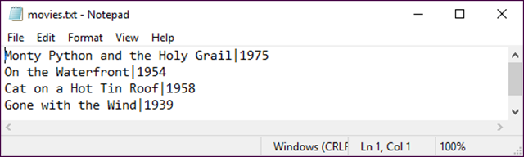
The data in the text file after one record has been added to it

Slide 37
The code for the write_movies and read_movies functions
# a file in the current directory
FILENAME = "movies.txt"
def write_movies(movies):
with open(FILENAME, "w") as file:
for movie in movies:
line = "|".join(movie)
file.write(f"{line}\n")
def read_movies():
movies = []
with open(FILENAME) as file:
for line in file:
line = line.replace("\n", "")
movie = line.split("|")
movies.append(movie)
return movies

Slide 38
The user interface for the Word Counter program
The Word Counter program
Number of words = 260
Number of unique words = 142
Word occurrences:
a = 7
above = 1
add = 1
...

Slide 39
The code for Word Counter program (part 1)
def get_words_from_file(filename):
with open(filename) as file:
text = file.read() # read str from file
text = text.replace("\n", "")
text = text.replace(",", "")
text = text.replace(".", "")
text = text.lower()
words = text.split(" ") # convert str to list
words.sort()
return words
def get_unique_words(words):
unique_words = []
unique_words.append(words[0])
for i in range(1, len(words)):
if words[i] == words[i - 1]:
continue
else:
unique_words.append(words[i])
return unique_words

Slide 40
The code for Word Counter program (part 2)
def main():
filename = "gettysburg_address.txt"
print("The Word Counter program\n")
# get words and unique words
words = get_words_from_file(filename) # get list of words
unique_words = get_unique_words(words)
# display number of words and unique words
print(f"Number of words = {len(words)}")
print(f"Number of unique words = {len(unique_words)}")
# display unique words and their word counts
print("Unique word occurrences:")
for word in unique_words:
print(f" {word} = {words.count(word)}")
if __name__ == "__main__":
main()

Slide 41
The user interface for the Hangman game
Play the H A N G M A N game
------------------------------------------------------------------------
Word: _ _ _ _ _ _ _ _ Guesses: 0 Wrong: 0 Tried:
Enter a letter: a
------------------------------------------------------------------------
Word: _ _ _ _ _ A _ _ Guesses: 1 Wrong: 0 Tried: A
Enter a letter: e
------------------------------------------------------------------------
Word: _ _ _ _ _ A _ _ Guesses: 2 Wrong: 1 Tried: A E
Enter a letter: i
------------------------------------------------------------------------
Word: _ _ _ _ _ A _ _ Guesses: 3 Wrong: 2 Tried: A E I
Enter a letter: o
------------------------------------------------------------------------
(The game continues)
------------------------------------------------------------------------
Word: B O U N _ A R Y Guesses: 13 Wrong: 6 Tried: A E I O U S N C L M R Y B
Enter a letter: d
------------------------------------------------------------------------Word: B O U N D A R Y Guesses: 14 Wrong: 6 Tried: A E I O U S N C L M R Y B D
------------------------------------------------------------------------Congratulations! You got it in 14 guesses.
Do you want to play again (y/n)?:

Slide 42
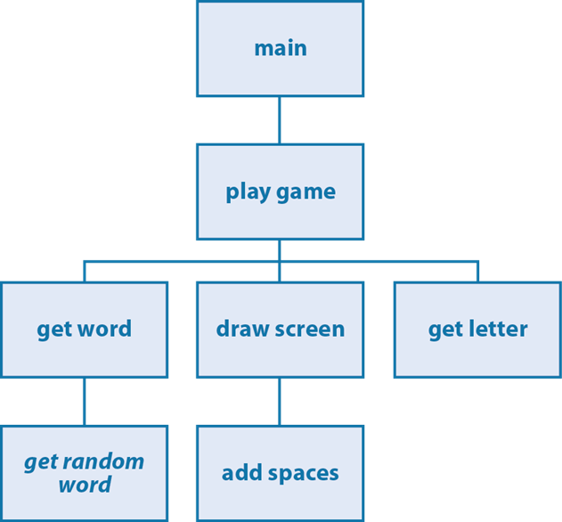
The hierarchy chart for the Hangman game

Slide 43
The wordlist module
import random
# List of words from
# http://www.free-teacher-worksheets.com/
words = [
"aardvark",
"air",
...
...
"zipper",
"zoo"
]
def get_random_word():
word = random.choice(words)
return word

Slide 44
The hangman module (part 1)
import wordlist
# Get a random word from the word list
def get_word():
word = wordlist.get_random_word()
return word.upper()
# Add spaces between letters
def add_spaces(word):
word_with_spaces = " ".join(word)
return word_with_spaces
# Draw the display
def draw_screen(num_wrong, num_guesses, guessed_letters,
displayed_word):
print("-" * 79)
print("Word:", add_spaces(displayed_word),
" Guesses:", num_guesses,
" Wrong:", num_wrong,
" Tried:", add_spaces(guessed_letters))

Slide 45
The hangman module (part 2)
# Get next letter from user
def get_letter(guessed_letters):
while True:
guess = input("Enter a letter: ").strip().upper()
# Make sure the user enters a letter and only one letter
if guess == "" or len(guess) > 1:
print("Invalid entry. ",
"Please enter one and only one letter.")
continue
# Don't let the user try the same letter more than once
elif guess in guessed_letters:
print("You already tried that letter.")
continue
else:
return guess

Slide 46
The hangman module (part 3)
# The input/process/draw technique is common in game programming
def play_game():
word = get_word()
word_length = len(word)
remaining_letters = word_length
displayed_word = "_" * word_length
num_wrong = 0
num_guesses = 0
guessed_letters = ""
draw_screen(num_wrong, num_guesses, guessed_letters,
displayed_word)

Slide 47
The hangman module (part 4)
while num_wrong < 10 and remaining_letters > 0:
guess = get_letter(guessed_letters)
guessed_letters += guess
pos = word.find(guess, 0)
if pos != -1:
displayed_word = ""
remaining_letters = word_length
for char in word:
if char in guessed_letters:
displayed_word += char
remaining_letters -= 1
else:
displayed_word += "_"
else:
num_wrong += 1
num_guesses += 1
draw_screen(num_wrong, num_guesses, guessed_letters,
displayed_word)

Slide 48
The hangman module (part 5)
print("-" * 79)
if remaining_letters == 0:
print(f"Congratulations! You got it in" {num_guesses} "
f"guesses.")
else:
print("Sorry, you lost.")
print(f"The word was: {word}")
def main():
print("Play the H A N G M A N game")
again = "y"
while again.lower() == "y":
play_game()
print()
again = input("Do you want to play again (y/n)?: ")
print("Bye!")
if __name__ == "__main__":
main()

